Slide 1

Binny Gill capstone project
Title: Enhancing Early Detection of Colon Cancer
Subtitle: Addressing the Challenges of Manual Histopathological Diagnosis

Slide 2
Business Question: Impact of Automated Colon Cancer Image Classification
Business Question
How can the implementation of an automated colon cancer image classification system improve diagnostic accuracy and efficiency in pathology labs, ultimately leading to better patient outcomes and reduced healthcare costs?

Slide 3
Stakeholders
Healthcare Professionals
Benefit from improved diagnostic accuracy.
Access to enhanced tools for patient assessment.
Patients
Potential for earlier detection of colon cancer.
Improved treatment outcomes through timely intervention.
Pathologists
Enhanced diagnostic support through AI tools.
Reduction of workload with automated image analysis.
Research Institutions
Collaboration opportunities for further studies.
Contribution to the advancement of AI in medical imaging.

Slide 4
Data Overview
total Number of Images: 10,000 images in total.
Folder Breakdown:
colon_aca: Contains [insert number] images (e.g., images of cancerous tissues).
colon_n: Contains [insert number] images (e.g., images of normal tissues).
Purpose of the Dataset: Explain the significance of analyzing both cancerous and non-cancerous tissues for improving diagnostic accuracy.

Slide 5
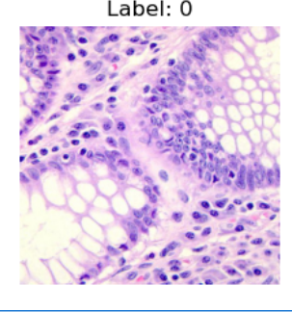
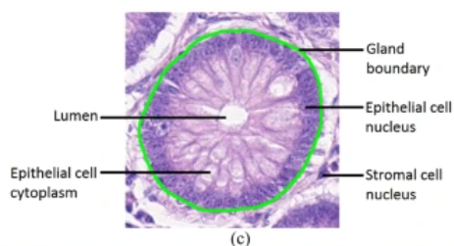
"Representative Images of Adenocarcinoma and Normal Colon Tissue"
Normal Tissue"

Slide 6
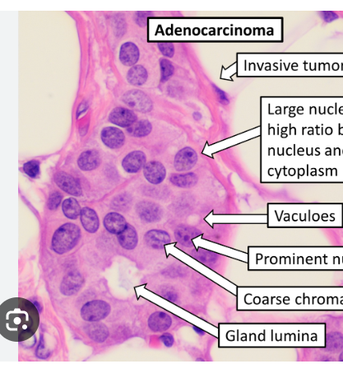
Here are representative images of adenocarcinoma, illustrating the key histopathological features characteristic of cancerous colon tissue."

Slide 7
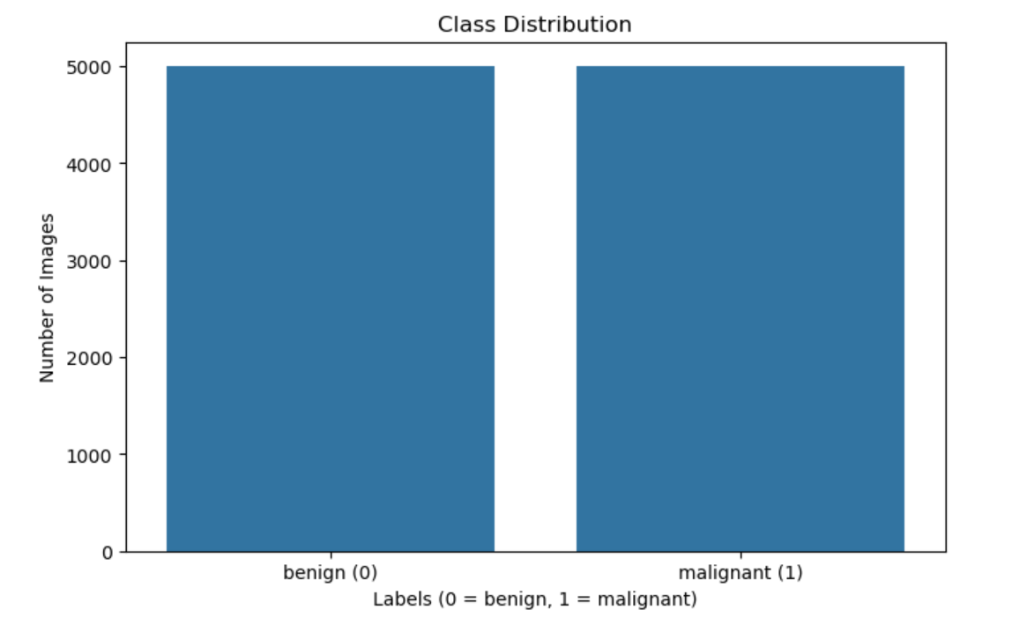
"This chart illustrates the distribution of images across the two classes—adenocarcinoma and normal colon tissue—demonstrating a well-balanced dataset with 2,500 images in each category, which is crucial for effective model training."

Slide 8
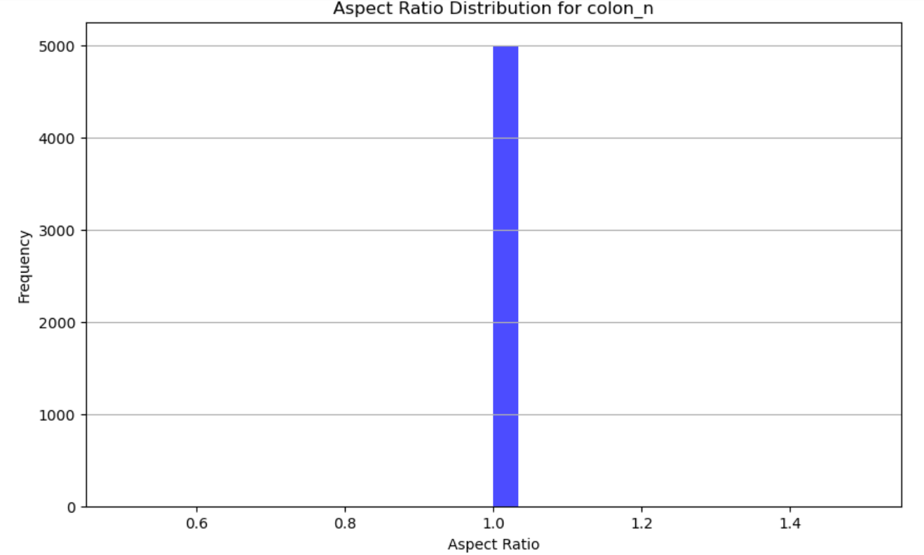
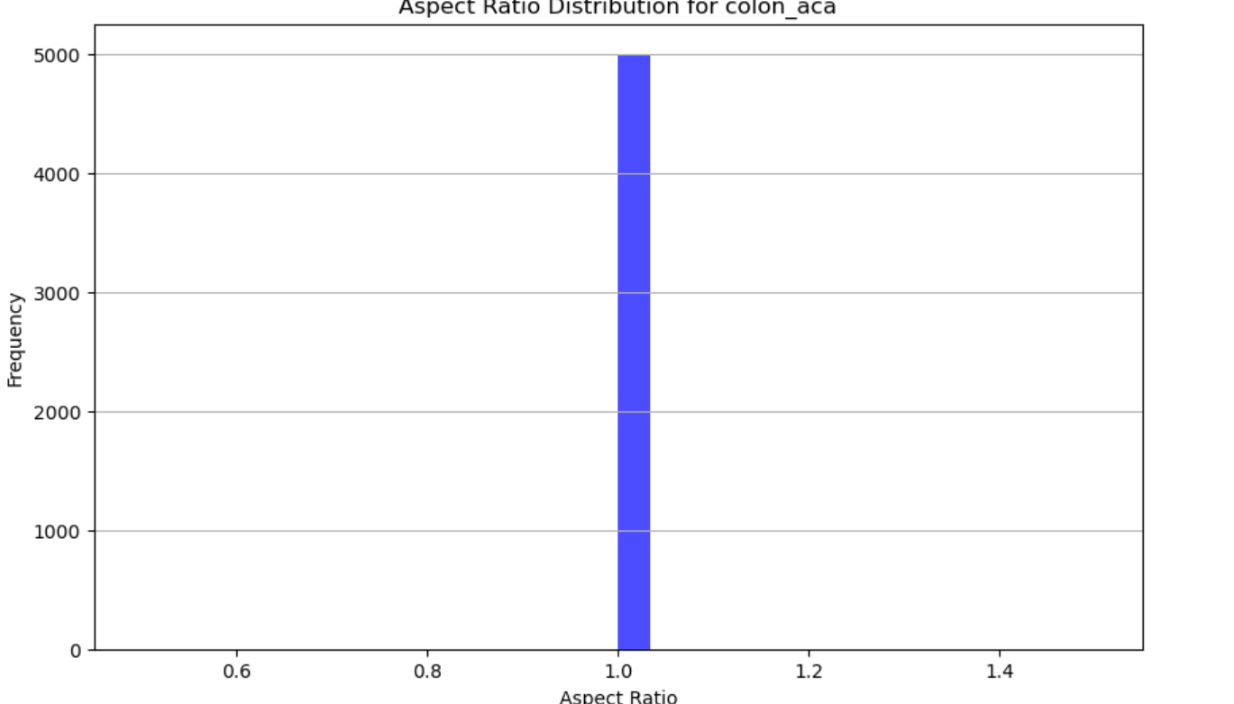
Aspect Ratio Distribution of Colon Images

Slide 9
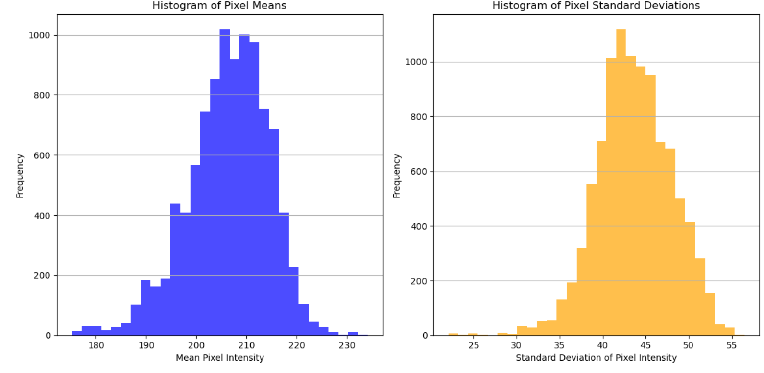
Pixel Mean and Standard Deviation incolon Image Processing
The peaks in the histograms suggest that most images have similar brightness characteristics.

Slide 10
Steps for Colon Cancer Image Classification
Data Preprocessing Organize images into structured directories and create a DataFrame for managing image paths and labels.
Create Data Generators Organize images into structured directories and create a DataFrame for managing image paths and labels.
Build the Model
Compile the Model Choose a CNN architecture chose VGG16, ResNet)
Train the Model Define optimizer, loss function, and metrics
Evaluate the Model
Visualize Results
Optimize the Model

Slide 11
Model Selection Rationale
Basic CNN
Strengths: Simple implementation; efficient and quick training.
Weakness: May struggle with complex patterns due to its simplicity.
ResNet50
Strengths: Deep architecture with residual connections enhances performance; effective transfer learning from pre-training.
Weakness: Computationally intensive, requiring significant resources.
VGG16
Strengths: Excellent feature extraction with a robust architecture; proven high accuracy in medical image classification.
Weakness: High memory usage and slower training times due to its depth.

Slide 12
Model Performance Summary
Three Models Evaluated:Simple CNN: Achieved an accuracy of 50.00% with a loss of 0.6931.
ResNet50: Limited performance with an accuracy of 79.95% and loss of 0.4633.
VGG16: Demonstrated superior performance with an accuracy of 1.00% and a significantly loss of 0.0.

Slide 13
Title: Model Performance Analysis: CNN vs EfficientNetB0
CNN Model Performance
Training Loss: 0.6931
Validation Loss: 0.6931
Training Accuracy: 50.83%
Validation Accuracy: 50.0%
Key Insight: Underfitting; accuracy near chance level.
resnet50 Performance
Training Loss: 1.8699e-05
Validation Loss: 0.0
Training Accuracy: 98.8
Validation Accuracy: 68%
Key Insight: Overfitting; potential data leakage.

Slide 14
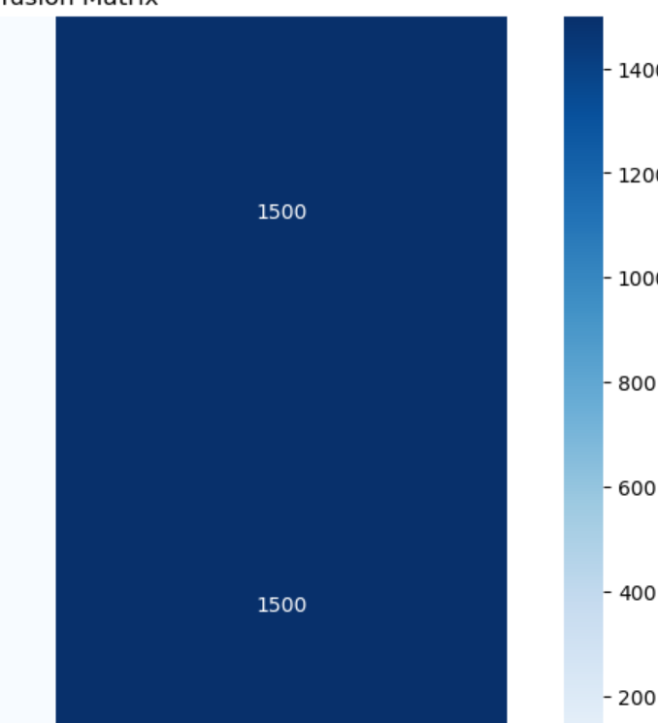
Title: CNN Performance for Colon Cancer Image Classification
The training and validation accuracies being around 50% suggest
that the model is not performing better than random chance.
Precision of 0.25 indicates that only 25% of positive predictions were correct,
which is concerning.
Recall of 0.50 suggests that the model is identifying 50% of the actual positives,
which is moderate but still needs improvement.

Slide 15
Model Overview: VGG16 is a deep convolutional neural network renowned for its architecture, featuring small (3x3) convolutional filters.
Training Performance:
Training Loss:
Initial: 0.4037
Final: 0.0648
Training Accuracy:
Initial: 90.44%
Final: 97.70%
Validation Performance:
Validation Loss:
Initial: 0.0517
Final: 0.0213
Validation Accuracy:
Initial: 98.20%
Final: 99.27%
Key Insights:
The model shows strong performance with high training and validation accuracy.
Continuous decrease in validation loss indicates good generalization capabilities.

Slide 16
Model Performance Overview
. Key Metrics
Accuracy: 0.978
Validation Score: 0.994
Loss: 0.056
Overall Accuracy: 0.980
2. Insights
High accuracy and validation scores indicate strong model performance.
Low loss value reflects effective learning and generalization.
3. Conclusion
The model shows reliable performance and is well-suited for application.
Considerations for future improvements or deployments.

Slide 17
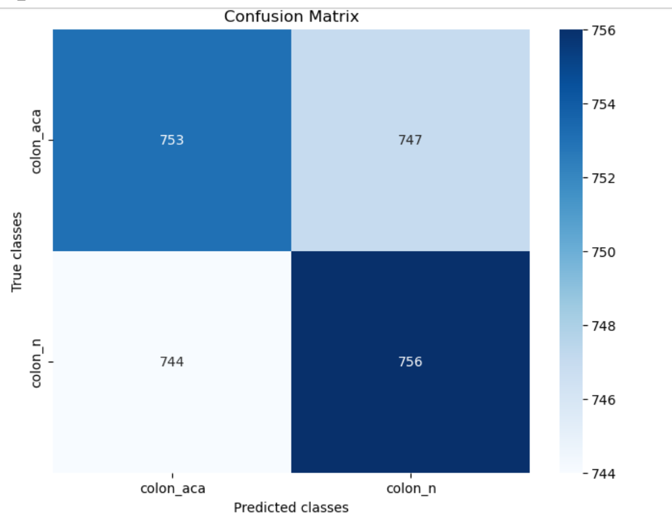
Confusion Matrix Analysis
Example Values
True Positives (TP): 522
False Positives (FP): 4
False Negatives (FN):1
True Negatives (TN): 465

Slide 18
Limitations of Colon Cancer Imaging Classification
1. Data Limitations
Insufficient Data Diversity: Limited representation of diverse demographics can affect model generalization.
Quality of Images: Variability in imaging quality can lead to inconsistent model performance.
2. Infrastructure Challenges
Computational Resources: High-quality imaging analysis requires significant computational power, which may not be accessible in all healthcare settings.
Storage and Management: Handling large volumes of imaging data necessitates robust storage solutions and data management practices.

Slide 19
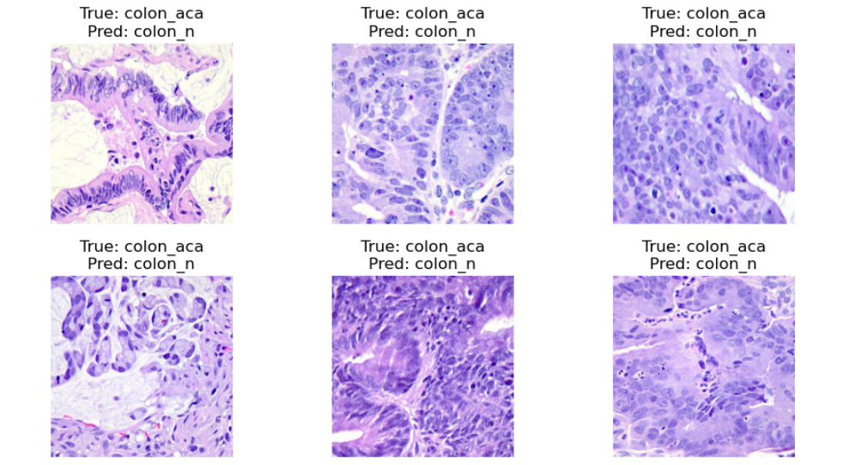
predicted Images from VGG16 Model
Actual Label: The true class of the image.
Predicted Label: The model's predicted class.

Slide 20
Final Statement
In conclusion, the VGG16 model has demonstrated promising results in predicting colon cancer images, achieving high accuracy and effectively identifying key features. However, the analysis of predicted images reveals areas for improvement, particularly in handling misclassifications. Continuous refinement of the model through techniques such as hyperparameter tuning, and the incorporation of additional data will be essential for enhancing its performance. Moving forward, these insights will guide our efforts in developing a robust tool for early detection in clinical settings.

